Slide 1



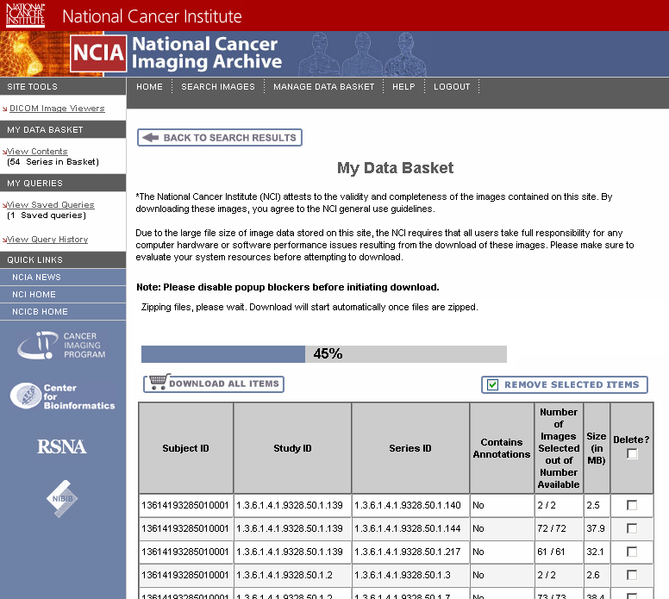

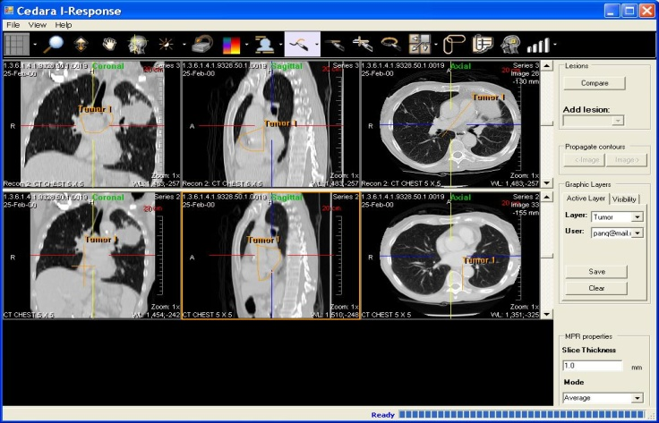
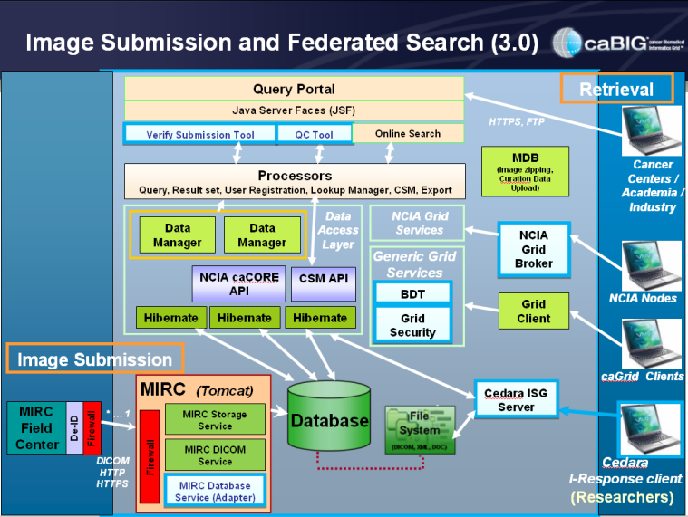
National Cancer Imaging Archive (NCIA)
Leveraging Imaging in Biomarker Discovery and Clinical Research
INTRODUCTION
IMAGE SEARCH AND DOWNLOAD
An initiative within the National Cancer Institute, the National Cancer Imaging Archive (NCIA) is a searchable repository of in vivo cancer images. The system provides the cancer research community with public access to de-identified images in DICOM format along with rich metadata, annotations, and markup.
Users can search and securely download images added to their data basket online
GOALS
The overall goal of the effort is to design and develop an in vivo imaging infrastructure that directly aligns with Cancer Bioinformatics Grid (caBIG) principles and the NIH roadmap towards improved patient care and targeted therapies.
The NCIA is to be used in the development and validation of analytical software such as computer-aided diagnosis (CAD) tools as well as access to images for interpretation for ongoing studies. Access the NCIA online, https://imaging.nci.nih.gov/
IMAGE VISUALIZATION
APPLICATION ARCHITECTURE
Cedara I-ResponseTM loads selected series for visualization
Central reads supported with recently implemented image markup storage and retrieval mechanism
Built using Java J2EE technology
caGrid enabled to support federated search
Support for Bulk Data Transport with gridFTP
Data access layer built using the caCORE SDK
FUTURE PLANS
Future enhancements to the NCIA will include caCORE CSM 3.2 integration, migration to the eXtensible Imaging Platform (XIP) architecture, in addition to improvements to the NCIA web user interface to improve system usability.
Acknowledgements and Support
This effort was supported by funds from National Cancer Institute,
the National Cancer Institute Center for Biomedical informatics and Information Technology,
and the Cancer Imaging Program.
Acknowledgements for Research Support
Acknowledgements for Research Support
Acknowledgements for Research Support

